Slide 2
Introduction to Data and Dataset

Slide 3
What is Data ?
Data refers to individual facts, measurements, or observations. (Datum-singular)
These are raw, unprocessed pieces of information
Examples:
  A single temperature reading: 28°C
  A single user name: "John Doe”
  A single sales figure: ₹5000
  Multiple temperature readings: 28°C , 30°C , 34°C , 29°C , 25°C
  Multiple user names: “John Doe”, “Alice, “Rachel”
  Multiple sales figure: ₹5000, ₹4000, ₹3000, ₹1000
Datum: Single piece of information, smallest unit of data
Data: Multiple data points/ values
Notes:
Datums – data points
Data represent a collection of data points

Slide 4
What is Data ? (contd…)
Nature: Data can be structured, semi-structured, or unstructured
Granularity: It's the smallest unit of information that is meaningful
Notes:
Datums – data points
Data represent a collection of data points

Slide 5
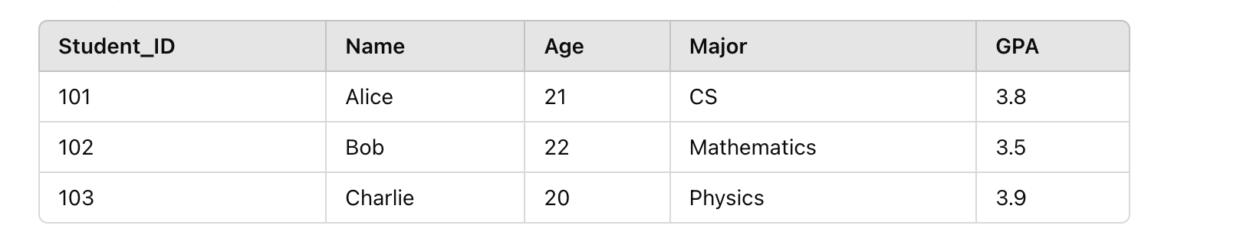
What is Dataset ?
Collection of data objects and their attributes.
Data Object (Row 1): {101, Alice, 21, CS, 3.8}
Data Object (Row 2): {102, Bob, 22, Mathematics, 3.5}
Attributes (Columns): Student_ID, Name, Age, Major, GPA
Data Points (Individual Values): 101, Alice, 21, etc.
Notes:
Data Object refers to an entity or instance in the dataset. It is usually a row in a table that represents one complete record.Data Point usually refers to an individual measurement or value within a data object.

Slide 6
What is Dataset ?
An attribute is a property or characteristic of an object:
  Examples: eye color of a person, temperature, etc.
  Attribute is also known as variable, field, characteristic, dimension, or feature
A collection of attributes describe an object:
  Object is also known as record, point, case, sample, entity, or instance
In case of ML
In case of ML

Slide 7
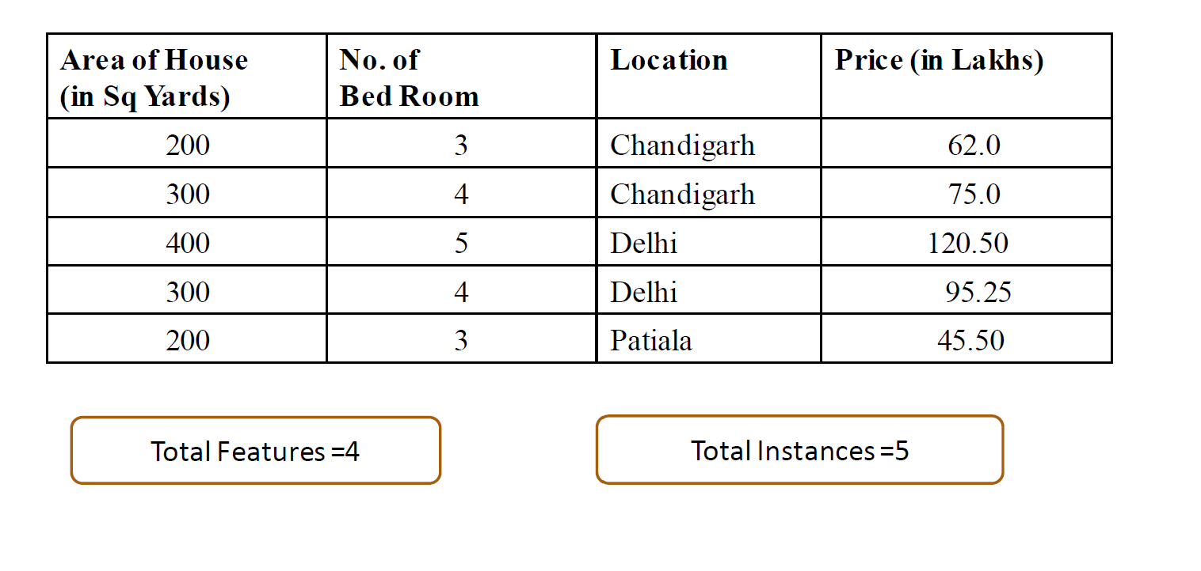
Dataset
Label/ Target/ Outcome/Dependent Variable (Y)
Y={Price in Lakhs}
Features/Dimension/Attributes of Dataset
X ={Area, No. of bed room, Location}

Slide 8
Dataset Classification
On the basis of Structure
On the basis of Machine Learning Usage
On the basis of label
On the basis of data type
Structured
Semi-Structured
Un-Structured
Training
Test
Validation
Labelled
Unlabelled
Qualitative
Quantitative

Slide 9
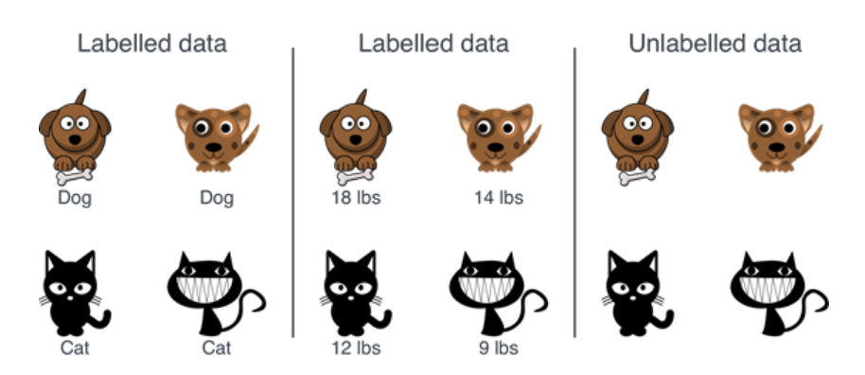
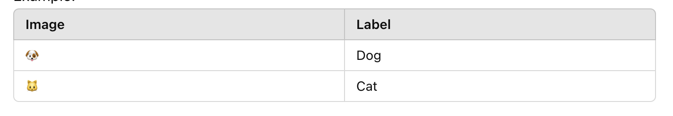
Labelled Dataset
Labelled Dataset-:
  Labelled dataset contains both input data (features) and corresponding output data (labels or targets).
  Each data point has an associated label that provides the correct answer or classification.
Characteristics:
  Contains Labels: Each data point has a predefined outcome (e.g., "cat" or "dog" in image classification).
Example:
  For an image of a cat, the label might be "cat" .
  In a dataset for house prices, features like area and number of rooms, locations are inputs, and the price is the output or label.

Slide 10
Unlabelled Dataset
Unlabelled Dataset-:
  A dataset is unlabelled when it contains only input data (features) without any corresponding labels.
  The outcomes or groupings are unknown, and the task is to infer structure or patterns in the data.
Characteristics:
  No Labels: The dataset has only input data without predefined outcomes.
Examples:
  Images without labels (e.g., no indication whether an image is a "cat" or "dog").
  Sensor data where patterns need to be discovered (e.g., IoT data).

Slide 11
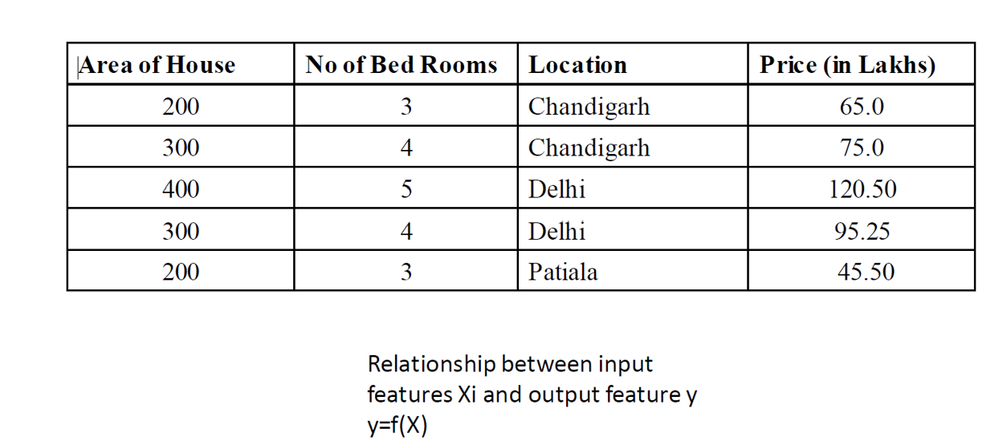
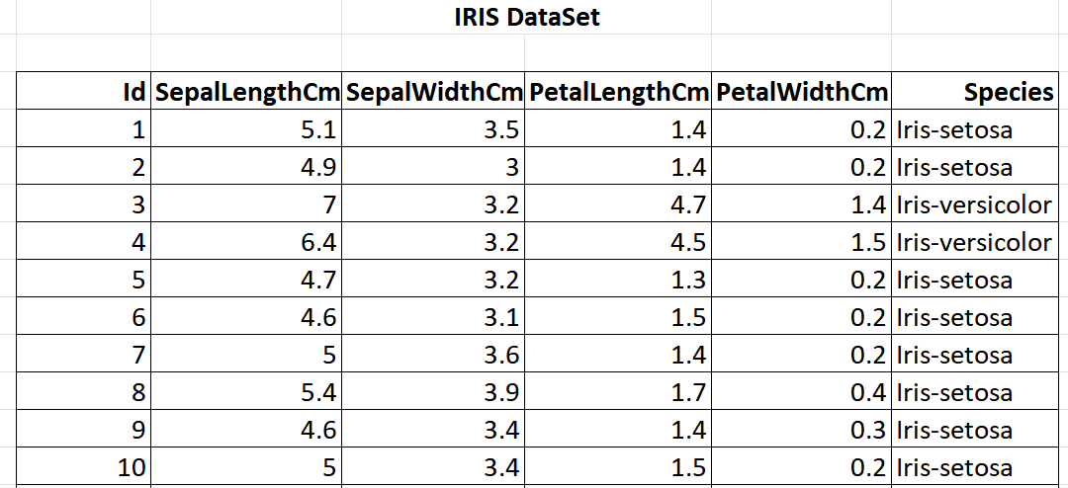
Labelled Dataset
Price is the Label
Inputs- Id, SepalLength, SepalWidth, PetalLength, PetalWidth
Output/Target variable- Species
A dataset for house prices
Dataset for flowers’ species
Species is the Label
Inputs-Area of House, No. of Bed Rooms, and Location
Output/Target variable- Price

Slide 12
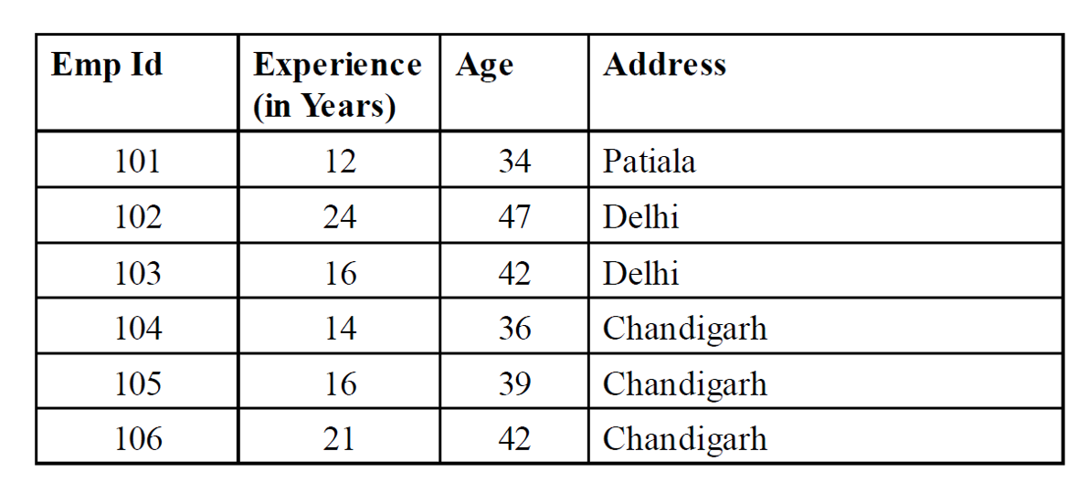
Unlabelled Dataset
Dataset for Employee
Inputs- Emp Id, Experience, Age, Address
Output/Target variable- Does not include the output/target variable.

Slide 13
Attribute/Features Values
Attribute or feature values are numbers or symbols assigned to an attribute or feature for a particular object
Distinction between attributes and attribute values:
  Same attribute can be mapped to different attribute values.
  Example: Height can be measured in feet or meters.
  Different attributes can be mapped to the same set of values.
  Example: Attribute values for ID and age are integers.

Slide 14
Types of Features/ Attribute
Features
Qualitative
Qualities
Nominal
No inherit order
Ordinal
Meaningful order
Quantitative
Quantities
Interval
No true Zero-point
Ratio
True Zero point
Binary
2 states

Slide 15
Qualitative Features
Qualitative features represent categories or qualities.
These are also called categorical variables.
Non-numerical, thus no arithmetic operations
  Gender (Male, Female), Color (Red, Blue), Eye color, Grades (A,B,C)
Types of Qualitative Features:
  Nominal Features
  Ordinal Features

Slide 16
Qualitative Features
Nominal Features:
  Categories with no inherent order or ranking.
  Examples:
      Colors: {Red, Blue, Green}
      Gender: {Male, Female, Non-binary}
      Types of vehicles: {Car, Truck, Bike}
Binary:
  Nominal attribute with only 2 states (0 and 1)
  Symmetric binary: both outcomes equally important e.g., gender
  Asymmetric binary: outcomes not equally important. e.g., medical test (positive vs. negative)
  Convention: assign 1 to most important outcome (e.g., HIV positive)

Slide 17
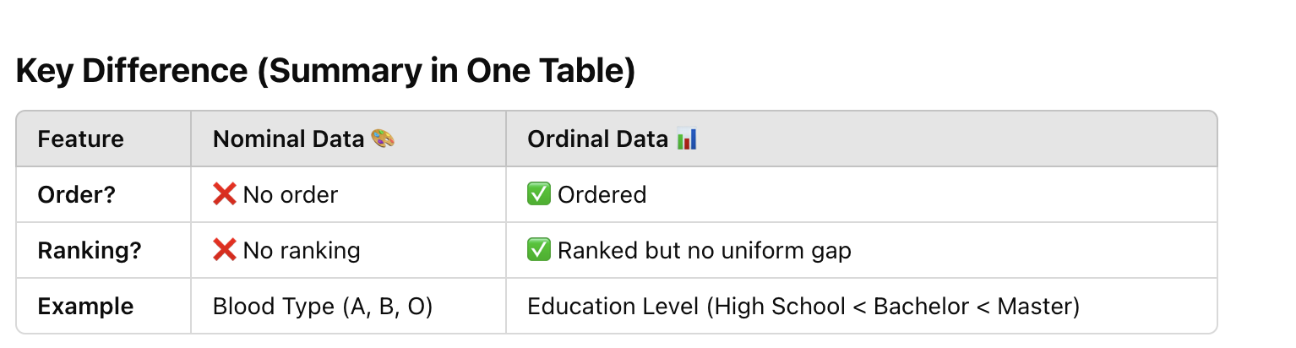
Qualitative Features
Ordinal Features:
  Categories with a meaningful order, but the differences between them are not measurable.
  Examples:
    Education level: {High School, Bachelor’s, Master’s, PhD}
    Likert scale: {Strongly Disagree, Disagree, Neutral, Agree, Strongly Agree}
    Size: {Small, Medium, Large}

Slide 18
Qualitative Features - Characteristics
Cannot perform arithmetic operations (e.g., addition, subtraction).
Usually represented as strings or encoded as numbers.
{High School, Bachelor’s, Master’s, PhD}
{10, 4, 2, 5}

Slide 19
Quantitative Features
Quantitative features represent numerical values (Continuous or Discrete).
These are also called numerical variables.
Numerical variables can have Continuous or Discrete value.

Slide 20
Quantitative Features
Discrete values:
  Represent countable values (integers).
  Examples:
    Number of students in a class: {10, 15, 20}
    Number of cars owned: {0, 1, 2, 3}
Continuous values:
  Represent measurable values on a continuous scale.
  They can take any value within a range.
  Examples:
    Temperature: {36.5°C, 37.2°C}
    Height: {165.2 cm, 170.8 cm}
    Income: ₹45,500.75
Can only take specific, distinct values.
No intermediate values exist between two numbers
Can take any value within a given range.
Has infinite possibilities within an interval.

Slide 21
Types of Quantitative Features
1. Interval Data
Numerical data where the difference between values is meaningful, but there is no true zero point, ratios are meaningless.
Characteristics:
  The intervals between values are equal and meaningful.
  Arithmetic operations like addition and subtraction are valid.
  Ratios cannot be calculated since there is no true zero.
Examples:
  Temperature in Celsius or Fahrenheit (e.g., 10°C is not "twice as hot" as 5°C because 0°C doesn’t mean "no temperature").
  Dates (e.g., 2000 AD is not twice as old as 1000 AD).
Key Note: Zero is arbitrary and does not indicate the absence of the variable being measured.
Notes:
Differences between values are meaningful (10°C to 20°C is the same difference as 20°C to 30°C).
❌ No true zero → 0°C does not mean "no temperature" (it is just another point on the scale).
❌ Ratios are meaningless → 20°C is NOT twice as hot as 10°C.

Slide 22
Types of Quantitative Features
2. Ratio Data
Ratio data is numerical data where the difference between values is meaningful, and there is a true zero point (i.e., zero indicates "nothing") and ratios are meaningful.
Characteristics:
  Both addition/subtraction and multiplication/division are valid.
  Ratios are meaningful (e.g., 4 is twice as large as 2).
  Contains a true zero, which represents the total absence of the variable.
Examples:
  Height (e.g., 0 cm means no height).
  Weight (e.g., 0 kg means no weight).
  Income (e.g., ₹0 means no income).
  Temperature in Kelvin (0 K represents the absence of thermal energy).
Notes:
✅ Differences are meaningful (100 cm to 150 cm is a 50 cm difference).
✅ True zero exists → 0 cm means “no height” (absolute absence).
✅ Ratios are meaningful → A person who is 180 cm is twice as tall as someone who is 90 cm.

Slide 23
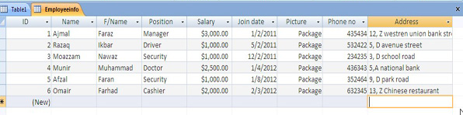
Structured data
Data that can be processed, stored, and retrieved in a fixed format.
It refers to highly organized information that can be readily and seamlessly stored and accessed from a database by simple search engine algorithms.
Example-The employee table in a company database will be structured as the employee details, their job positions, their salaries, etc., will be present in an organized manner.

Slide 24
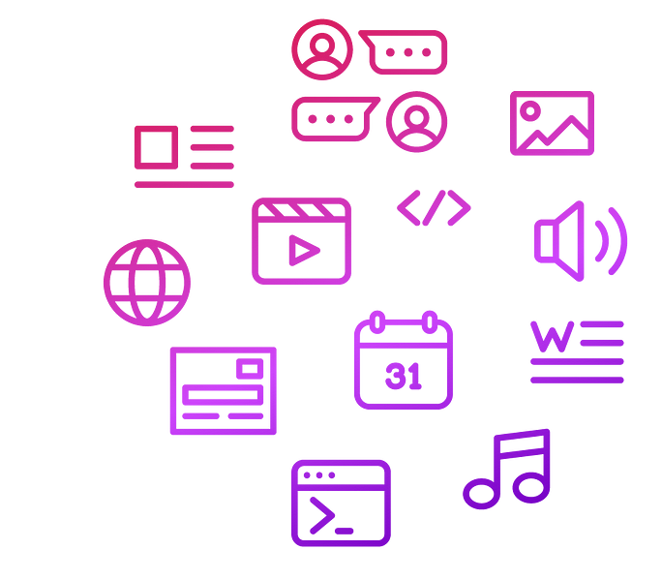
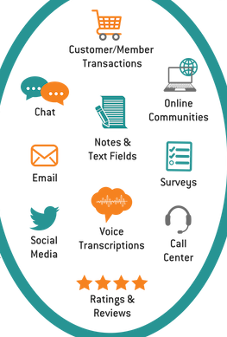
Unstructured data
Refers to the data that lack any specific form or structure whatsoever.
This makes it very difficult and time-consuming analyze unstructured data.
Stored in data lakes, NoSQL (Not Only Structured Query Language) databases, or cloud-based systems.
Free-form or undefined format (e.g., text, images, videos, audio).

Slide 25
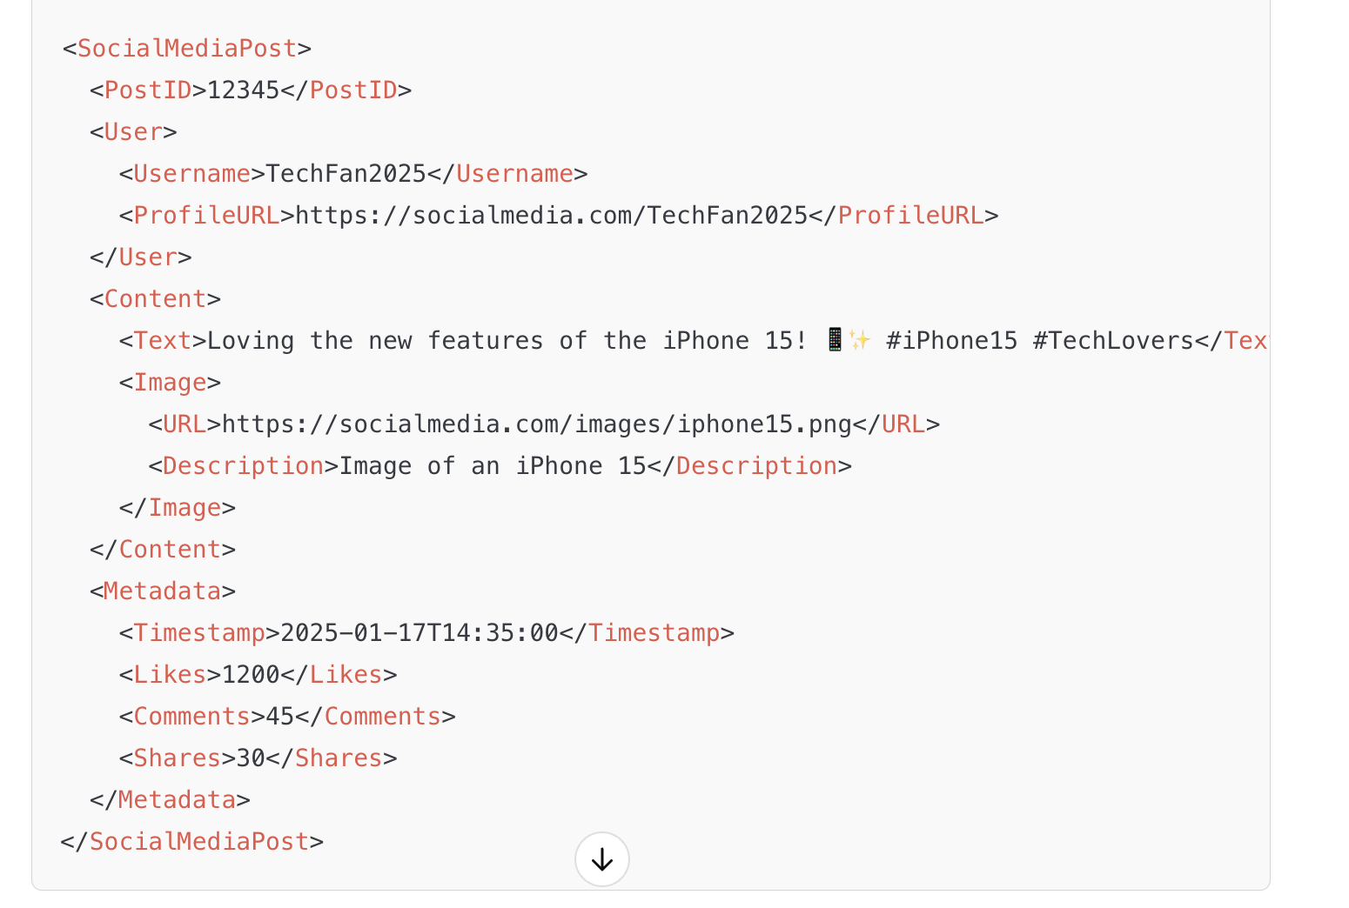
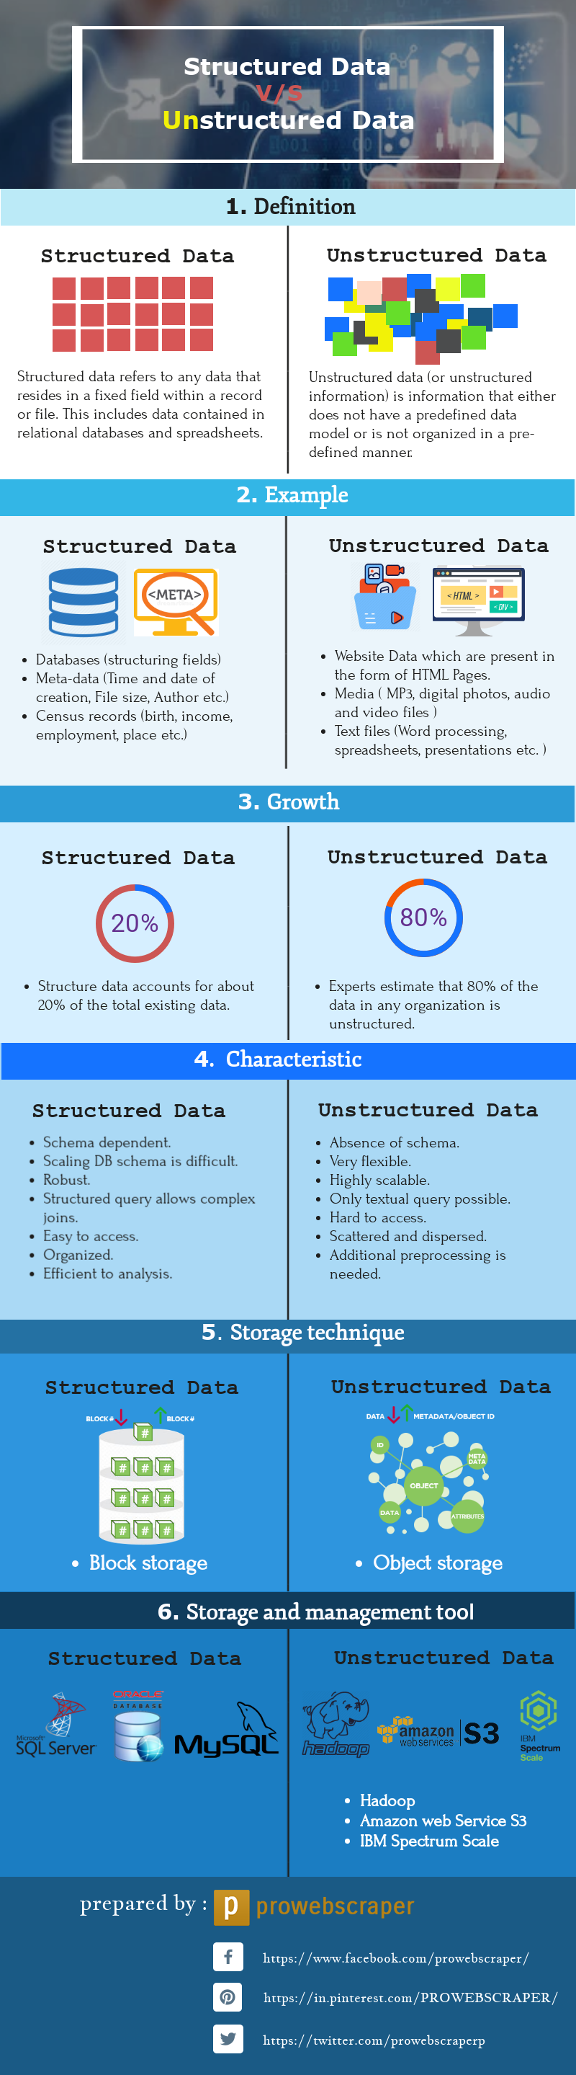

Slide 26

Semi-structured data
Pertains to the data containing both the formats mentioned above, that is, structured and unstructured data.
To be precise, it refers to the data that although has not been classified under a particular repository (database), yet contains vital information or tags that segregate individual elements within the data.
Example- Email
  The written content of an email is unstructured, whereas the there are some inherent structure to the information in each email, such as the sender’s name, recipient address, recipient name and date sent.

Slide 27
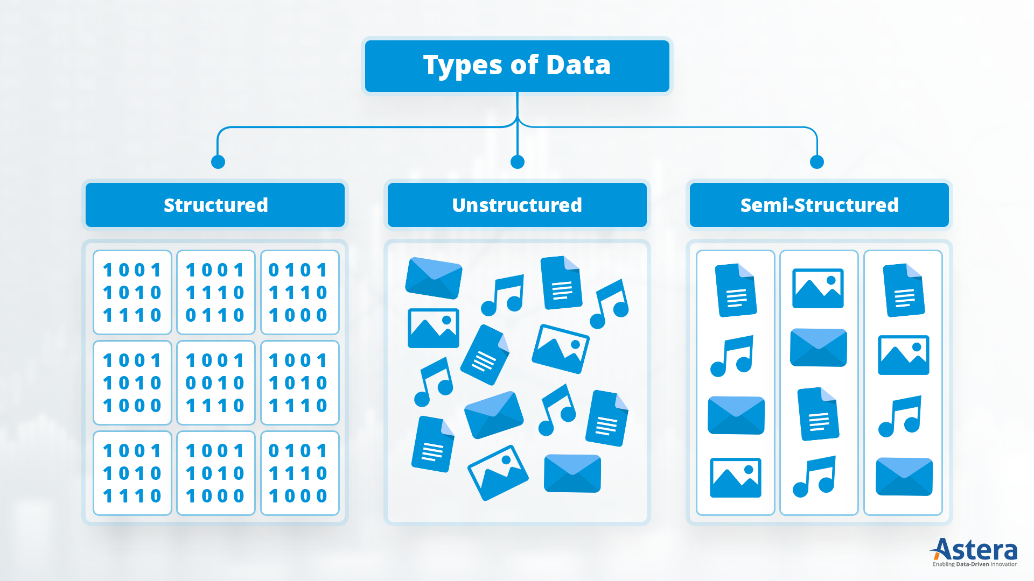
Bank Transactions:
Fields: Transaction ID, Account Number, Date, Amount, Merchant Name.
Social Media Posts:
Facebook posts, tweets, Instagram captions, and hashtags.
Emails with Metadata:
The body is unstructured, but metadata like sender, receiver, subject, and timestamp is structured.

Slide 28
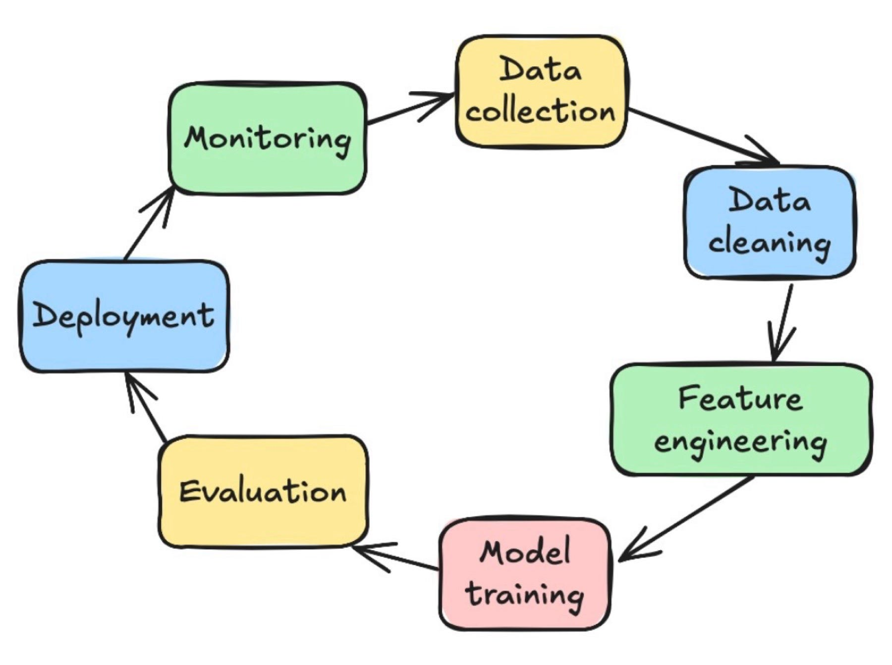

Slide 29
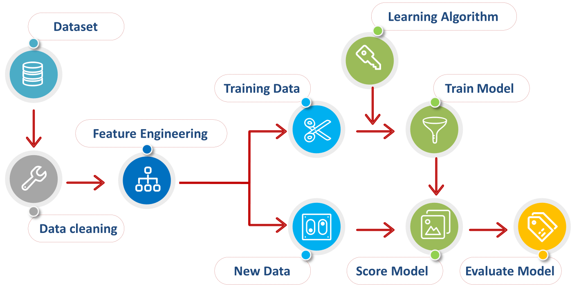

Slide 30

DATA PREPROCESSING

Slide 31

01
Sources of Data
02
Web Scraping
What We'll Cover
03
Popular Scraping Libraries
04
Data Annotation Basics
05
Tools & Best Practices

Slide 32

Collecting Data
Manual Collection
Involves gathering data by hand, through surveys, forms, or curated downloads. Useful for small or niche datasets.
Public Sources
Open datasets from platforms like Kaggle, UCI, or government portals offer diverse, well-documented datasets.
APIs & Databases
APIs like Twitter or Reddit APIs allow structured data pulls; internal databases are often used for business-specific ML.

Slide 33
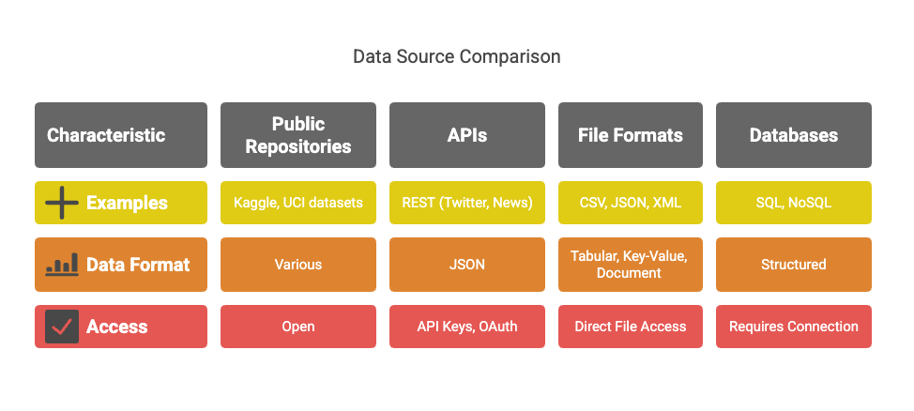
Understanding where data comes from is critical.
a. Public Repositories:
Kaggle Datasets: https://www.kaggle.com/datasets
UCI Machine Learning Repository: https://archive.ics.uci.edu/ml/
b. APIs:
REST APIs (e.g., Twitter, News API, Google Maps)
Typically return JSON data
Require API keys or OAuth
c. File Formats:
CSV – Common for tabular data
JSON – Key-value structure, used with APIs
XML – Document structure, used in legacy systems
d. Databases:
SQL (MySQL, PostgreSQL)
NoSQL (MongoDB, Firebase)

Slide 34

Scraping Data
What is Web Scraping?
Web Scraping is the automated process of extracting data from websites. It allows access to large amounts of unstructured data.
How the Web Works:
Websites are rendered using HTML
You interact via HTTP requests (GET, POST)
Responses contain structured info (tables, divs, spans)
Legal & Ethical Concerns
Always check the site’s terms of service. Avoid scraping personal or copyrighted content without permission.
Scraping Targets
E-commerce, news, social media, and public records are common scraping targets for ML training data.

Slide 35
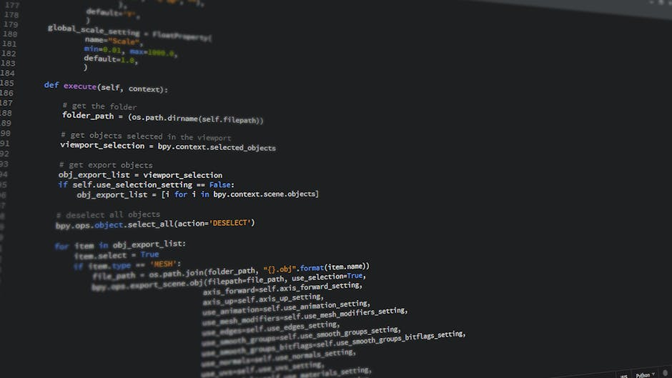
Popular Scraping Libraries
BeautifulSoup (simplest): Parses HTML into searchable objects.
A Python library for parsing HTML and XML. It’s beginner-friendly and works well with static pages.
Scrapy (advanced): For large-scale and structured scraping.
A powerful framework for large-scale scraping with built-in handling for requests, pipelines, and spiders.
Selenium (Used when content loads dynamically via JavaScript.)
Simulates browser behavior and can scrape JavaScript-heavy websites by automating browser interaction.

Slide 36
Data Collection Using APIs
APIs provide structured access to live data streams.
a. Anatomy of an API:
  Endpoint: URL for the resource
  Method: GET/POST/PUT/DELETE
  Headers: Metadata, tokens
  Response: Usually in JSON
b. Tools:
  requests in Python
  tweepy for Twitter
  newsapi-python for news articles
c. Example:
import requests
url = "https://newsapi.org/v2/top-headlines?country=in&apiKey=YOUR_KEY"
response = requests.get(url)
data = response.json()
for article in data['articles'][:5]:
print(article['title'])

Slide 37
Challenges in Data Collection
Incomplete data | APIs return partial results
Dynamic websites | Require JavaScript rendering (need Selenium)
Rate limits | Many APIs allow only X requests/hour
Legal restrictions | Data scraping can violate ToS or data laws
Bias | Source of data may skew outcomes
Anonymization | Sensitive data must be stripped of PII (Personally Identifiable Information)

Slide 38

What is Data Annotation?
Why Annotate?
Machine learning models need labeled data for supervised learning. Annotations provide ground truth for training.
Common Types
Classification labels, bounding boxes, segmentation masks, and entity recognition tags are common annotations.
Impact on Accuracy
High-quality annotations lead to better model performance, while poor labeling introduces noise and errors.

Slide 39
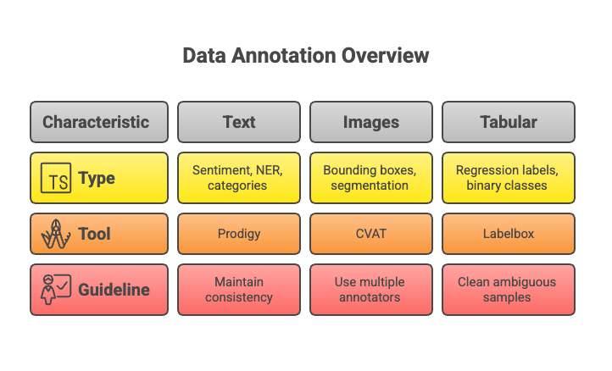
Machine learning models (esp. supervised) require labeled data.
a. Types:
  Text: Sentiment, NER, categories
  Images: Bounding boxes, segmentation
  Tabular: Regression labels, binary classes
b. Tools:
  Labelbox (cloud-based)
  CVAT (open-source, for images)
  Prodigy (for text/NLP)
  LightTag (team annotation)
c. Guidelines:
  Maintain consistency
  Use multiple annotators for reliability
  Clean ambiguous samples

Slide 40
Annotation Tools & Methods
Manual Annotation
Platform Solutions
Automation Aids
Tools like LabelImg or VGG Image Annotator are great for small, focused datasets.
Services like Labelbox, Scale AI, and SuperAnnotate offer scalable and collaborative labeling workflows.
Active learning and semi-supervised techniques help reduce human workload and improve speed.

Slide 41
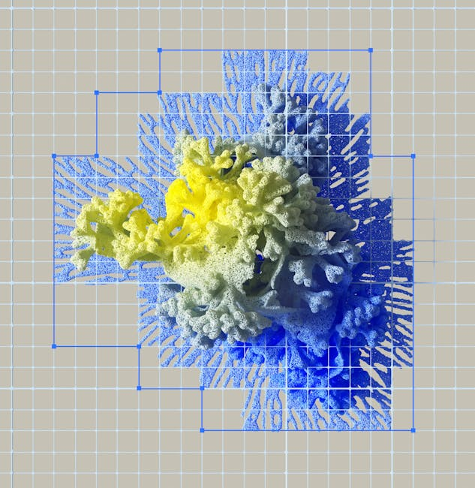
• Always consider data privacy and user consent.
• Respect copyright and licensing restrictions.
• Automate wisely: balance speed with annotation quality.
• Validate data with domain experts when possible.
• Keep a consistent format and schema.
Challenges & Best Practices
Ethical and Practical Considerations

Slide 42
Annotation Strategy
How do you balance data quantity vs. quality?
Discussion & Reflection
Larger datasets may boost performance, but only if the labels are reliable. Prioritizing high-quality, well-annotated data often yields better results in real-world ML scenarios.

